Slide 1
Health Literacy
Background & assignment
Notes:
Welcome to our discussion on health literacy. This presentation will provide an overview of organizational health literacy and introduce an assignment on the topic of health literacy in maternal and child health care organizations.

Slide 2
Template Guidelines
The following slides may be used to explain and discuss the Health Literacy in Maternal and Child Health assignment and how it can be used in your classroom.
This presentation can be used in its entirety or adapted as desired. Slides can be added, deleted, or changed to meet the needs of your class.
This presentation and the attached assignment is suggested for use by both introductory and special topic Maternal and Child Health courses.
The creation of this toolkit was funded by the Association of Teachers of Maternal and Child Health and assembled by a team at the University of South Florida.

Slide 3
Setting the Stage
Maternal and child health
Notes:
In order to understand the importance of health literacy, we will look at the systems and services involved in maternal and child health.

Slide 4
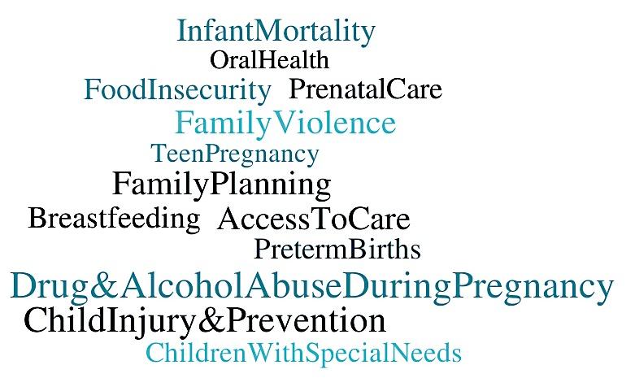
Select Maternal and Child Health Issues
Notes:
Maternal and child health issues are influenced by health literacy. An individual’s ability to obtain health information, utilize health services, and make health decisions are critical to the following issues:
Infant mortality
Preterm births
Prenatal care
Drug and alcohol abuse during pregnancy
Breastfeeding
Child injury and prevention
Children with special needs
Family violence
Teen pregnancy
Family planning
Food insecurity
Oral health
Access to care

Slide 5
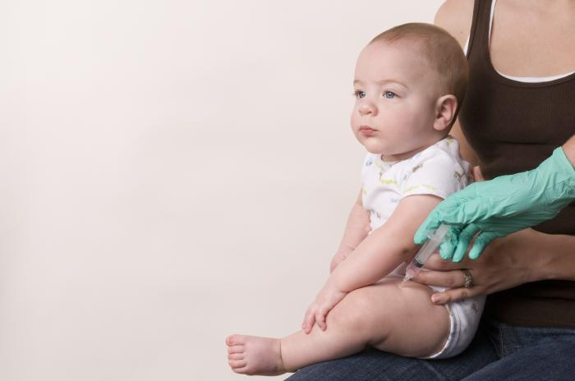
Maternal and Child Health Systems
Complex systems of services to be navigated
How many different services will a pregnant woman navigate, beginning with conception?
Notes:
Throughout a woman’s life, she will navigate many different health care services. Each of these services will require a different set of procedures and skills from her, and the extent to which these organizations are health literate will impact her capacity to get the services that she needs. Maternal and child health covers a wide variety of services and systems, from primary pediatric care to family planning clinics.
Let’s look at an example. How many different services will a mother navigate, beginning with the conception and continuing through the child’s fifth birthday? She may receive services from all of the following: her prenatal care provider, WIC, her dental provider, a hospital or birthing center, her child’s pediatrician, her child’s dentist, mental health care providers, etc. Health literacy plays in important role in how effective these health services will be in providing her with information that is critical to her health and the health of her child.

Slide 6
Health Literacy
Background
Notes:
Let’s examine the concept of health literacy.

Slide 7
Health Literacy
The degree to which an individual has the capacity to obtain, process, and understand basic health information and services (Ratzan and Parker, 2000)
The product of an individual’s capacity and the health-literacy related demands and complexities of the health care system (Baker, 2006; Rudd, 2003)
Notes:
Health literacy is the extent to which individuals are able to obtain, process, and understand basic health information and services needed to make appropriate health decisions. This is influenced by individual traits, as well as by the nature of the health information and services.
While health literacy was traditionally considered an individual trait, there is a growing understanding that health literacy is a product of an individual’s capacity combined with the nature of the systems and services that individuals are required to navigate. The health literacy of a population is improved when the demands of health care systems are aligned with the public’s skills and abilities.
Organizational health literacy assesses the degree to which health care organizations are working to ensure their services can be navigated by the populations that they serve.
The capacity to obtain, process, and understand basic health information and services needed to make appropriate health decisions (Ratzan and Parker, 2000)
The product of an individual’s capacity and the health-literacy related demands and complexities of the health care system (Baker, 2006; Rudd 2003)

Slide 8
Health Literacy Matters
People with limited health literacy are more likely to:
Have chronic conditions that they cannot manage effectively
Have less knowledge of their health conditions
Not utilize preventative services
Be admitted to the hospital or emergency room for preventable reasons
Report their health condition as poor
Have higher healthcare costs
Notes:
Limited health literacy costs the nation between $106 and $236 billion annually
People with limited health literacy are more likely to:
Have chronic conditions that they cannot manage effectively
Have less knowledge of their health conditions
Not utilize preventative services
Be admitted to the hospital or ER for preventable reasons
Report their health condition as poor
Have higher healthcare costs
Source: http://health.gov/communication/literacy/quickguide/factsbasic.htm

Slide 9
Who is at risk for low health literacy?
Older adults
Racial and ethnic minorities
People with less than a high school degree or GED certificate
People with low income levels
Non-native speakers of English
People with compromised health status
Notes:
Individuals with limited health literacy are more likely to be older adults, racial and ethnic minorities, have less than a high school degree or GED certificate, have low income, be non-native speakers of English, and have compromised health status.
Source: http://health.gov/communication/literacy/quickguide/factsbasic.htm

Slide 10
Everyone is At Risk
9 out of 10 Americans have poor health literacy (National Assessment of Adult Literacy, 2003)
Poor health literacy is “a stronger predictor of a person's health than age, income, employment status, education level, and race.” (American Medical Association, 1999)
Notes:
Health literacy impacts everyone, and most Americans do not have adequate health literacy. This is impacting heath outcomes throughout our population.
Sources:
U.S. Department of Health and Human Services. (2003). Health Literacy: Why we need accessible health information. Retrieved from http://health.gov/communication/literacy/issuebrief/
Ad Hoc Committee on Health Literacy for the Council on Scientific Affairs, American Medical Association. (1999). Health Literacy: Report of the Council on Scientific Affairs. JAMA.;281(6):552-557.

Slide 11
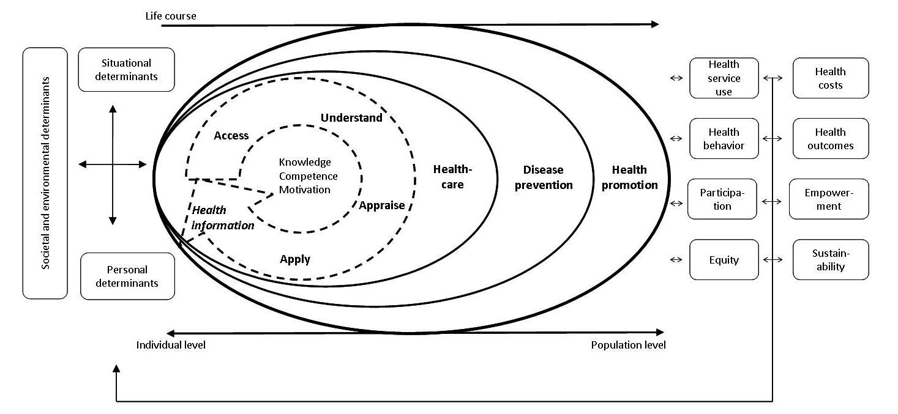
Health Literacy in Public Health
(Sorenson, et al., 2015)
Notes:
This figure presents an integrated conceptual model of health literacy.
Health literacy is a process with consecutive steps of accessing, understanding, appraising, and applying health information.
The three domains of the health continuum are healthcare, disease prevention, and health promotion.
Each step can be applied to each of the domains, with varying impacts on health outcomes.
This is a logical model that shows the proximal factors or personal determinants (such as age, race, etc.), situational determinants (such as media use, peer influence, etc.), and distal factors or societal determinants (such as political forces, societal systems, etc.) which influence health literacy.
The pathways link health literacy to health outcomes.
Source:
Sorensen, K., Van den Broucke, S., Fullam, J., Doyle, G., Pelikan, J., Slonska, Z., & Brand, H. (2012).
Health literacy and public health: A systematic review and integration of
definitions and models. BMC Public Health, 12, 80. http://doi.org/10.1186/1471-2458-12-80

Slide 12
National Priorities
Healthy People 2010 and 2020
Plain Writing Act of 2010
IOM’s Priority Areas for National Action
AHRQ’s Universal Precautions Toolkit
DHHS’s National Action Plan to Improve Health Literacy
Notes:
Health Literacy has been established as a national priority. It is included in Health People 2010 and 2020, the Plain Writing Act of 2010 (and specifically applied to health in the Affordable Care Act), the IOM’s report on Priority Areas for National Action, the Agency for Healthcare Research and Quality’s Universal Precautions Toolkit, and the US Department of Human Health and Service’s National Action Plan to Improve Health Literacy.
Healthy People 2020 Objective HC/HIT-1: Improve the health literacy of the population
Three measures:
Increase the proportion of persons who report their health care provider always gave them easy-to-understand instructions about what to do to take care of their illness or health condition
Increase the proportion of persons who report their health care provider always asked them to describe how they will follow the instructions
Increase the proportion of persons who report their health care providers’ office always offered help in filling out a form
ACA Section 1331: Patient communication must be given in plain language. The term ‘‘plain language’’ means language that the intended audience, including individuals with limited English proficiency, can readily understand and use because that language is concise, well-organized, and follows other best practices of plain language writing.“
ACA Section 1001: Health insurance companies and group health plans must use language that is linguistically and culturally appropriate when communicating with insurance enrollees. The standards shall ensure that the summary is presented in a culturally and linguistically appropriate manner and utilizes terminology understandable by the average plan enrollee.

Slide 13
10 Attributes of a Health Literate Health Care Organization (2012)
Institute of Medicine Roundtable on Health Literacy
Objective: “to make it easier for people to navigate, understand, and use information and services to take care of their health” (Brach, 2012 )
Most relevant to organizations that provide health care directly
i.e. inpatient units, community health centers, group practices, clinics, pharmacy practices, etc.
Notes:
The 10 Attributes of a Health Literate Health Care Organization is a report generated in 2012 by the IOM’s Roundtable on Health Literacy. The objective of this report is “to make it easier for people to navigate, understand, and use information and services to take care of their health.” The ten attributes exemplify a health literate health care organization and are intended to be aspirational guideposts. Each attribute is followed by a set of implementation strategies, which give organizations practical guidelines for improving their health literacy.

Slide 14
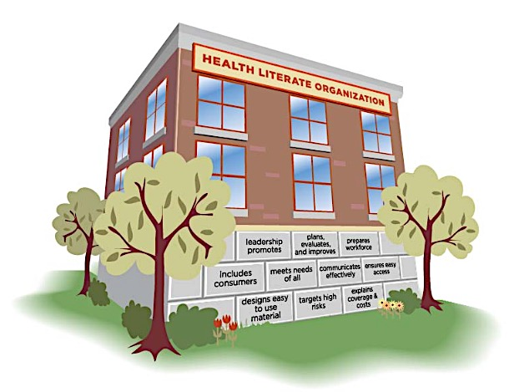
The 10 Attributes
Notes:
The following attributes exemplify a health literate health care organization.
The IOM Roundtable acknowledges that these attributes are intended to be aspirational, and that “becoming a health literate organization is a process and achieving each attribute moves the organization along the continuum closer to becoming a health literate organization” (Institute of Medicine [IOM], 2011, p. 19).

Slide 15
Attribute 1
Has leadership that makes health literacy integral to its mission, structure, and operation.
Notes:
Has leadership that makes health literacy integral to its mission, structure, and operation.

Slide 16
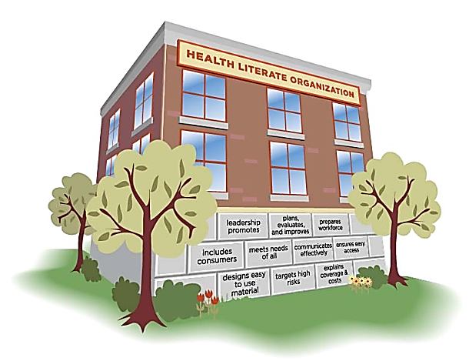
Leadership In Practice
IOM Suggested Guidelines:
Organizational leaders:
Set goals for health literacy improvement, provide incentives to achieve those goals, and establish accountability for outcomes at every level of the organization.
Create a culture that values patient and consumer perspectives and emphasizes that communication is made up of two-way interactions between participants who have equally important roles.
MCH Example: What policies could support this in a WIC clinic?
Notes:
Each attribute is followed by a list of specific qualities that combine to produce the attribute. Here are two of the qualities included in this attribute. What could this look like, in practice? Brainstorm ideas.
Possible answers:
The director of each WIC clinic could set goals for their clinic to do things like: increase the proportion of women who leave with accurate information about their health, reduce misunderstandings about health information (both measurable by exit surveys), track progress, create financial incentives for departments that improve, etc. In order to measure the goals, systems for monitoring and consistent surveillance like follow-up phone calls with specific health questions could be established.
The director of each WIC clinic could implement periodic focus groups within the community they serve, continually working to better understand the needs of their community, and change their procedures to fit those needs. Staff trainings could include communication skill-building and emphasize the importance of listening to their clients.

Slide 17
Attribute 2
Integrates health literacy into planning, evaluation measures, patient safety, and quality improvement.
Notes:
Integrates health literacy into planning, evaluation measures, patient safety, and quality improvement.

Slide 18
Planning and Evaluating In Practice
IOM Suggested Guidelines:
Ensure that consumer surveys are designed to be understandable and easy to complete, and offer and provide assistance in completing surveys.
Track and report communication failures and conduct root cause analysis to uncover and address systematic sources of error.
MCH Example: What practices could support this in Head Start?
Notes:
Possible answers:
Examine survey methods, work to make surveys easier and more accurate (digital, phone calls, incentives)
Establish a system that records all communication failures in any department of the organization and works to identify the areas that are having continual issues
In cases of clients’ mishaps, remove blame on individual’ misunderstandings and reflect on the organization’s design and systems that played a role

Slide 19
Attribute 3
Prepares the workforce to be health literate and monitors progress.
Notes:
Prepares the workforce to be health literate and monitors progress.

Slide 20
Workforce Preparation In Practice
IOM Suggested Guidelines:
Hire diverse workforce with expertise in health literacy.
Evaluate health literacy skills of staff on an on-going basis, provide training to those who do not meet standards of excellence, and evaluate the impact of the training.
MCH Example: How could this be implemented in a dental clinic?
Notes:
Possible answers:
Clinic staff should reflect the community it serves and include diversity in terms of race/ethnicity, religion, sexual orientation, gender identification, culture, etc.
Identify staff who is not performing their job with health literacy, such as not following the protocol for using simple language, checking and confirming patient understanding, etc. by random observation, patient surveys, etc.
Design and evaluate training that fits into the staff’s schedule and builds understanding of their role in improving health literacy

Slide 21
Attribute 4
Includes populations served in the design, implementation, and evaluation of health information and services.
Notes:
Includes populations served in the design, implementation, and evaluation of health information and services.

Slide 22
Including Consumers In Practice
IOM Suggested Guidelines:
Include members of the population they serve in governing bodies.
Obtain and incorporate feedback on health information and services from individuals who use them.
MCH Example: How could this be practiced in a family planning clinic?
Notes:
Possible answers:
Create positions in the clinic’s executive board specifically for community members and ensure that their voices are heard
Send a representative of the family planning clinic to town hall meetings and community events
Randomly survey patients about their experiences in the clinic and use the feedback to design and change materials and procedures
Ask patients what could be done differently and consider revisions
Create a community-outreach position in the clinic’s administrative body whose job is to understand the needs of the community

Slide 23
Attribute 5
Meets the needs of populations with a range of health literacy skills while avoiding stigmatization.
Notes:
Meets the needs of populations with a range of health literacy skills while avoiding stigmatization.

Slide 24
Meeting Needs In Practice
IOM Suggested Guidelines:
Create an environment that is welcoming and does not impose high literacy demands.
Use written information to reinforce spoken communication and provide alternative to written materials.
MCH Example: How could this be implemented in a pediatrician’s office?
Notes:
Possible answers:
Easy to read posters with simple messages
A variety of printed literature available in different languages
Brochures and pamphlets that are up-to-date and use simple language and graphics to communicate messages
Make space for kids to play safely
Provide check-in services that do not require extensive paperwork and contact with multiple staff-members or movement between waiting rooms
Provide assistance in filling out paperwork
Provide written information in addition to verbal communication about the child’s health needs, medications, treatment plan, and services
Provide written information about services offered
Thoroughly explain information and check for understanding, never assuming that written information will be understood

Slide 25
Attribute 6
Uses health literacy strategies in interpersonal communications and confirms understanding at all points of contact.
Notes:
Uses health literacy strategies in interpersonal communications and confirms understanding at all points of contact.

Slide 26
Communication In Practice
IOM Suggested Guidelines:
Allow adequate time for all interactions.
Plan for and provide language assistance.
MCH Example: How could these standards impact an interaction at a pediatric specialist provider?
Notes:
Possible answers:
Doctors and nurses must allow enough time for the parents to ask questions, discuss concerns
Time is important in observing a child’s behavior
Families may travel long distances to see specialists and come from diverse backgrounds, with different language needs
Language assistance may be necessary for children, parents, and/or extended family
Complicated medical terminology combined with a language barrier leaves potential for misunderstanding
Specialists may work with high-risk cases where clear understanding of at-home treatment plans are critical

Slide 27
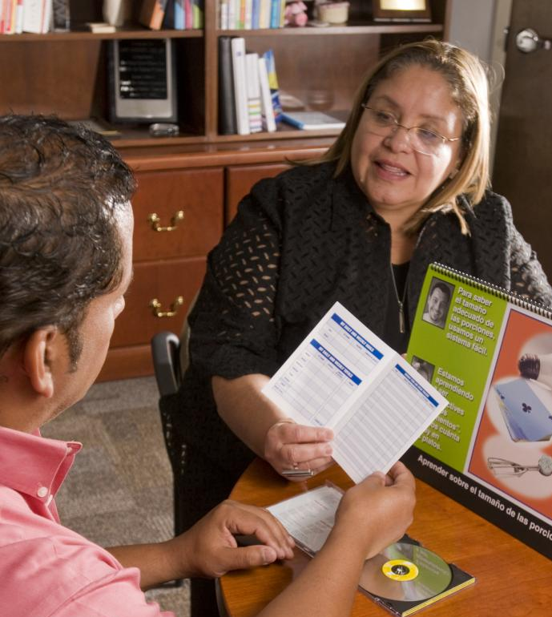
Attribute 7
Provides easy access to health information and services and navigation assistance.
Notes:
Provides easy access to health information and services and navigation assistance.

Slide 28
Ensuring Access In Practice
IOM Suggested Guidelines:
Design health care facilities with features that help people find their way.
Do not rely on patients to relay information among care providers.
MCH Example: What could this look like in a hospital?
Notes:
Possible answers:
Hospitals should help patients navigate the facility using: lots of signage, signs using clear graphics instead of words, simple language instead of complicated words, staff providing in-person navigational assistance, easy-to-understand maps. All new construction and renovations should be evaluated in terms of patient access and usability.
Set up systems of communication between providers via phone, internet, fax, etc. that removes the burden of transferring information from the patient as much as possible
Streamline electronic medical record services within hospitals to make all records accessible and available to each department

Slide 29
Attribute 8
Designs and distributes print, audiovisual, and social media content that is easy to understand and act on.
Notes:
Designs and distributes print, audiovisual, and social media content that is easy to understand and act on.

Slide 30
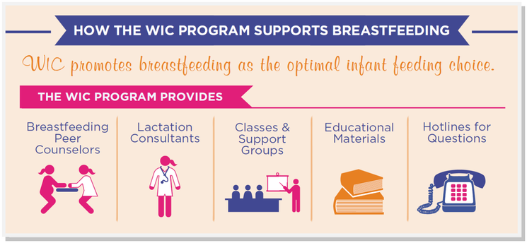
Material Design In Practice
IOM Suggested Guidelines:
Choose and create materials that make their purpose clear; use common words; focus on a limited number of messages; use simple visuals if they make the content more easily understood.
MCH Example: What makes this WIC flyer a quality material?
Notes:
Possible answers:
Clear and helpful graphics, simple layout, concise message, basic introduction to each service, pleasant design
Source: http://www.southern7.org/breastfeeding-support.html

Slide 31
Attribute 9
Addresses health literacy in high-risk situations, including care transitions and communications about medicines.
Notes:
Addresses health literacy in high-risk situations, including care transitions and communications about medicines.

Slide 32
Targeting High-Risk In Practice
Identify high risk-situations and topics that require extra attention and resources, and establish and implement plans to ensure safe communication.
Establishing an informed consent process (with specific standards).
MCH Example: What types of situations are high-risk in a domestic violence shelter?
Notes:
Possible answers:
Medical evaluation, in-take of children and their needs, allergy/medical history communication, explanation of privacy and safety protocols, transfer to hospital, etc.

Slide 33
Attribute 10
Communicates clearly what health plans cover and what individuals will have to pay for services.
Notes:
Communicates clearly what health plans cover and what individuals will have to pay for services.

Slide 34
Explaining Coverage Costs In Practice
Health literate insurers respond promptly and accurately to requests for information about coverage for specific treatments and procedures.
Health literate health care organizations communicate costs of care in advance.
MCH Example: What protocols in a student health center could meet these standards?
Notes:
Possible answers:
An online, telephone directory, and printed resource explaining which services are covered by student health plan and which services will be billed to insurance.
When making an appointment, insurance information is entered into system
Students are given estimates for the cost of their visit based on their specific insurance plans, both when they book their appointment and again when they are choosing services at the clinic.

Slide 35
Assignment
Assessing Health literacy in an MCH organization

Slide 36
Objectives
Explore the practical application of organizational health literacy
Utilize the IOM’s 10 Attributes as a tool to assess organizational health literacy
Identify the importance of health literacy in organizational structure and function
Gain insight into a local maternal and child health care organization

Slide 37
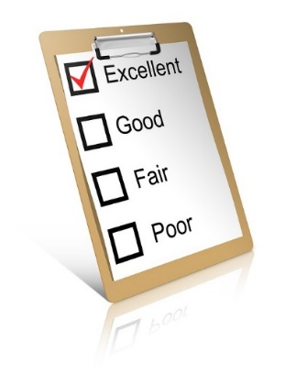
Assignment
Step 1. Choose a maternal and child health care organization
Step 2. Select 5 out of the 10 attributes
Step 3. Assess the organization*:
Research information and literature on the organization
Observe the organization using the selected attributes’ qualities
Interview a staff member on policies and procedures related to the selected attributes
Step 4. Summarize assessment and make recommendations:
Produce a report on the organization’s health literacy assessment
Present report to class
*See assignment sheet for details
Notes:
Assignment sheet includes additional instructions on choosing an organization, conducting an interview, and generating a report.

Slide 38
Additional Resources
AHRQ Health Literacy Universal Precautions Toolkit. (2016). Agency for Healthcare Research and Quality, Rockville, MD. Retrieved from http://www.ahrq.gov/professionals/quality-patient-safety/quality-resources/tools/literacy-toolkit/index.html
Baker, D. W. 2006. The meaning and the measure of health literacy. Journal of General Internal Medicine 21(8):878-883.
Brach, C., Keller, D., Hernandez, L.M., Baur, C., Parker, R., Dreyer, B., ... Schillinger, D. (2012). Ten attributes of health literate health care organizations. Institute of Medicine Roundtable on Health Literacy Discussion Paper. Retrieved from http://iom.edu/Global/Perspectives/ 2012/HealthLitAttributes.aspx
Ratzan SC, Parker RM. 2000. Introduction. In: National Library of Medicine Current Bibliographies in Medicine: Health Literacy. NLM Pub. No. CBM 2000-1. Selden CR, Zorn M, Ratzan SC, Parker RM, Editors. Bethesda, MD: National Institutes of Health, U.S. Department of Health and Human Services.
Sorensen, K., Van den Broucke, S., Fullam, J., Doyle, G., Pelikan, J., Slonska, Z., & Brand, H. (2012). Health literacy and public health: A systematic review and integration of definitions and models. BMC Public Health, 12, 80. http://doi.org/10.1186/1471-2458-12-80

